Slide 1
Parts Overview
Lego Mindstorms Unit
By Devin O’Brien

Slide 2
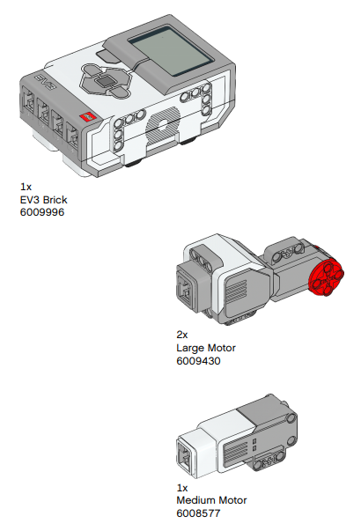
Brick & Motors
Brick 1x→
Large Motor 2x→
Medium Motor 1x→

Slide 3
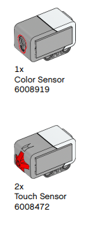
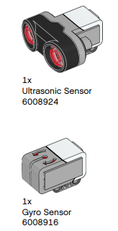
Sensors

Slide 4
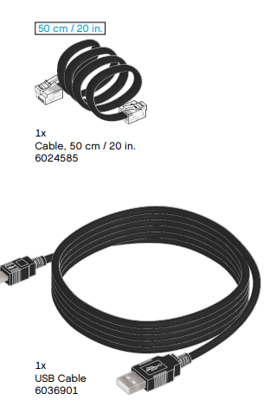
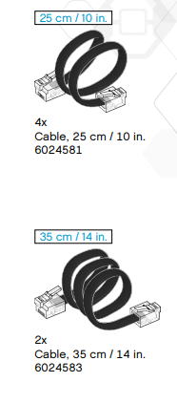
Cables
1 USB cord to connect to PC
Other cables connect motors
or sensors to brick

Slide 5
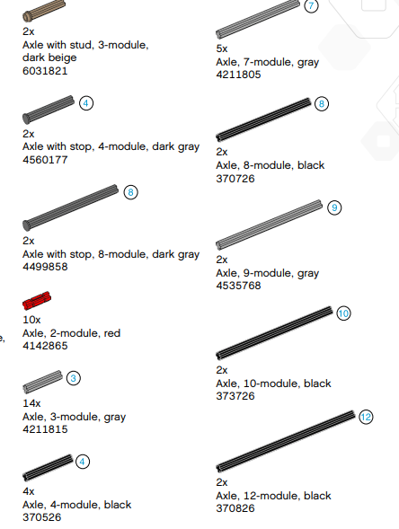
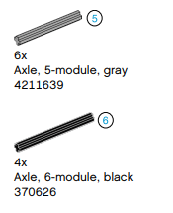
Axles
A rod or spindle (either fixed or rotating)
passing through the center of a wheel
or group of wheels.

Slide 6
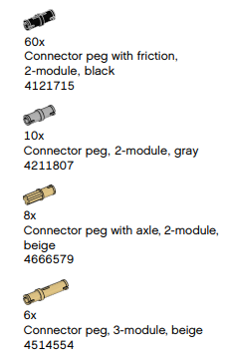
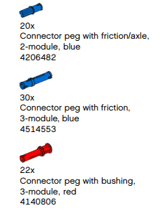
Connector Pegs

Slide 7
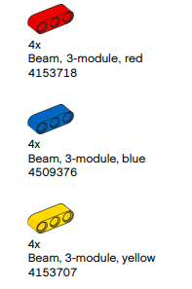
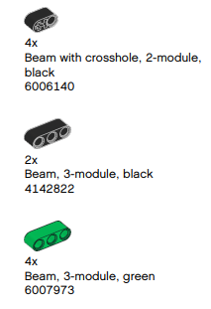
Short Beams
Beam-one of the principal horizontal supporting members (as of a building or ship).
Example: a steel beam supporting a floor.

Slide 8
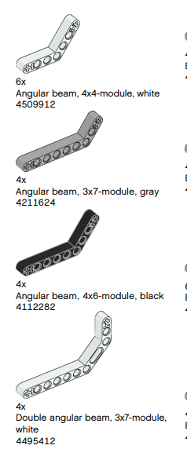
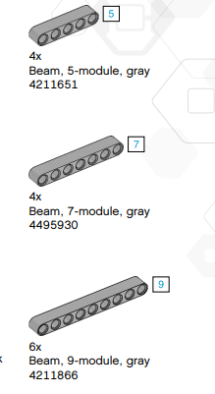
Long Beams

Slide 9
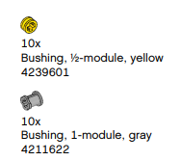
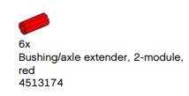
Bushings
A metal lining for a round hole,
especially one in which an axle revolves.

Slide 10
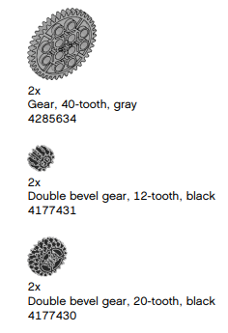
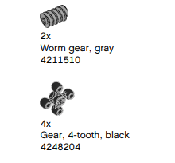
Gears
A toothed wheel

Slide 11
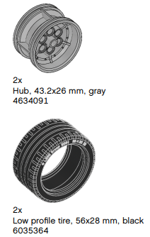
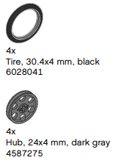
Tire and Hubs

Slide 12
Can you find more parts?
Use your resources to find any parts that were now shown. Try to find at least five.

Slide 13
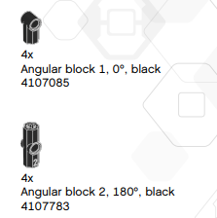
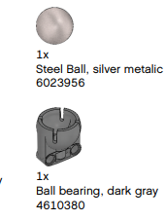
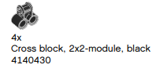
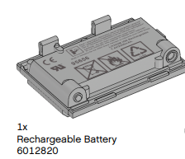
Some Other Parts

